Slide 1
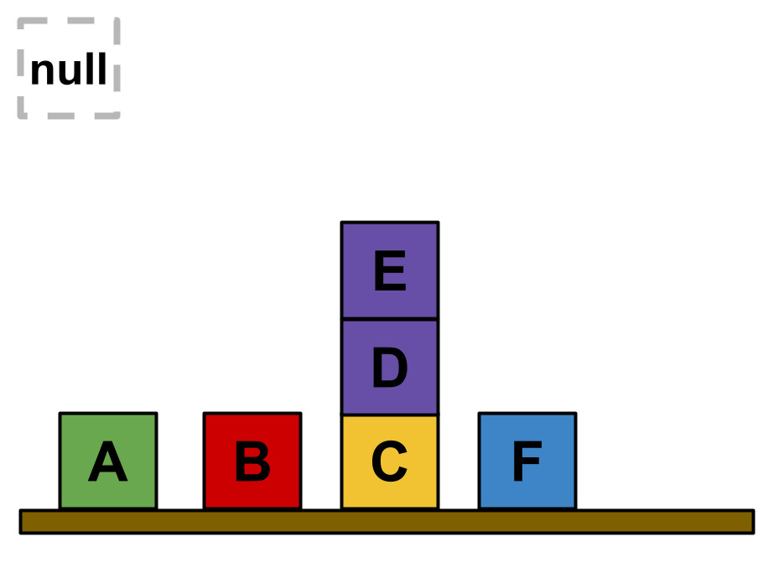
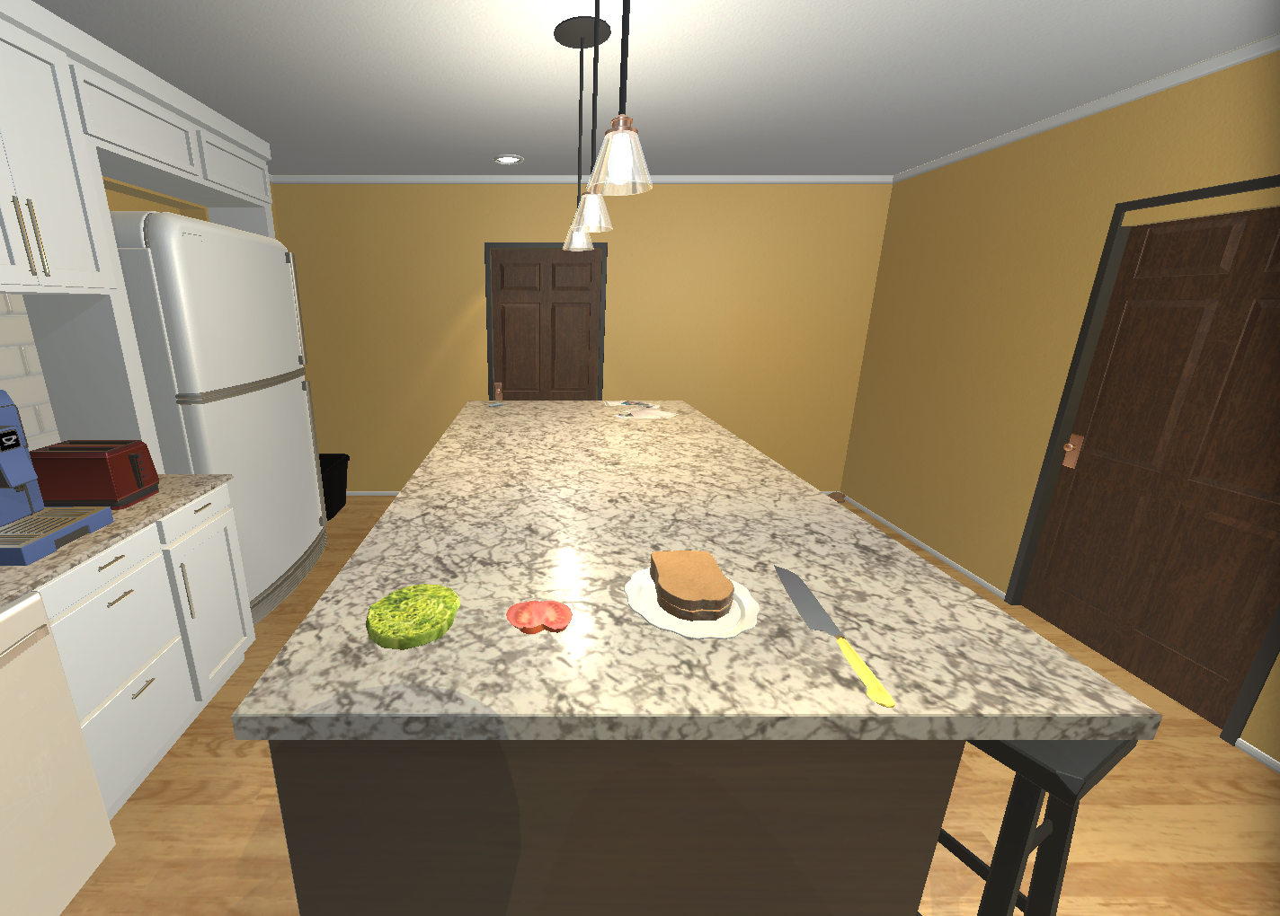
ColorBlocksworld
Kitchenworld
IsOnTable | block | isOnTable
1 | 2 | TRUE
2 | 3 | TRUE
3 | 4 | TRUE
4 | 5 | FALSE
5 | 6 | FALSE
6 | 7 | TRUE
IsClear | block | isClear
1 | 2 | TRUE
2 | 3 | TRUE
3 | 4 | FALSE
4 | 5 | FALSE
5 | 6 | TRUE
6 | 7 | TRUE
HasColor | block | hasColor
1 | 2 | green
2 | 3 | red
3 | 4 | yellow
4 | 5 | purple
5 | 6 | purple
6 | 7 | blue
HasLabel | block | hasLabel
1 | 1 | null
2 | 2 | A
3 | 3 | B
4 | 4 | C
5 | 5 | D
6 | 6 | E
7 | 7 | F
Empty | isEmpty
1 | 1
Gripper | isHolding
1 | 1
On | on_l | on_r
1 | 6 | 5
2 | 5 | 4

Slide 2
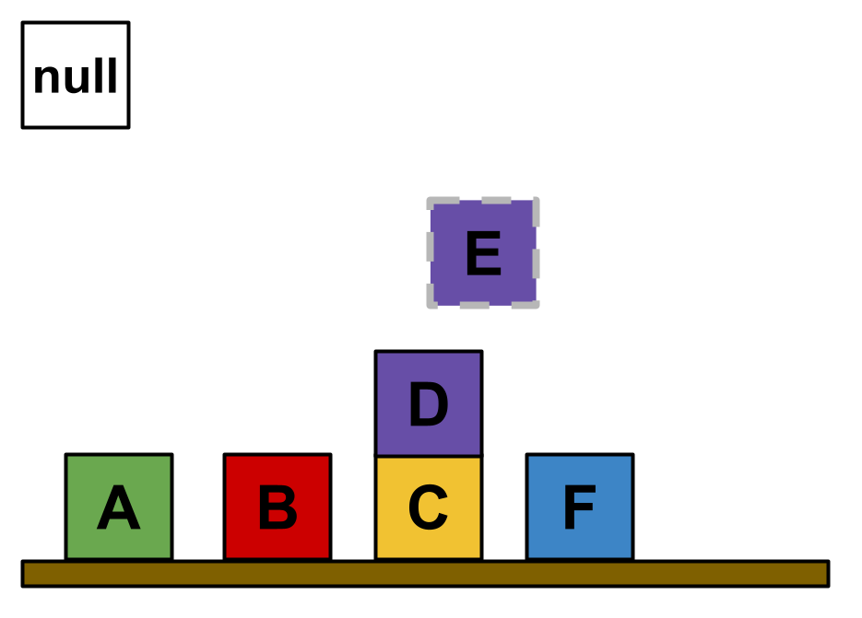
ColorBlocksworld
Kitchenworld
unstack E D
IsOnTable | block | isOnTable
1 | 2 | TRUE
2 | 3 | TRUE
3 | 4 | TRUE
4 | 5 | FALSE
5 | 6 | FALSE
6 | 7 | TRUE
IsClear | block | isClear
1 | 2 | TRUE
2 | 3 | TRUE
3 | 4 | FALSE
4 | 5 | TRUE
5 | 6 | TRUE
6 | 7 | TRUE
HasColor | block | hasColor
1 | 2 | green
2 | 3 | red
3 | 4 | yellow
4 | 5 | purple
5 | 6 | purple
6 | 7 | blue
HasLabel | block | hasLabel
1 | 1 | null
2 | 2 | A
3 | 3 | B
4 | 4 | C
5 | 5 | D
6 | 6 | E
7 | 7 | F
Empty | isEmpty
1 | 1
Gripper | isHolding
1 | 6
On | on_l | on_r
1 | 5 | 4

Slide 3
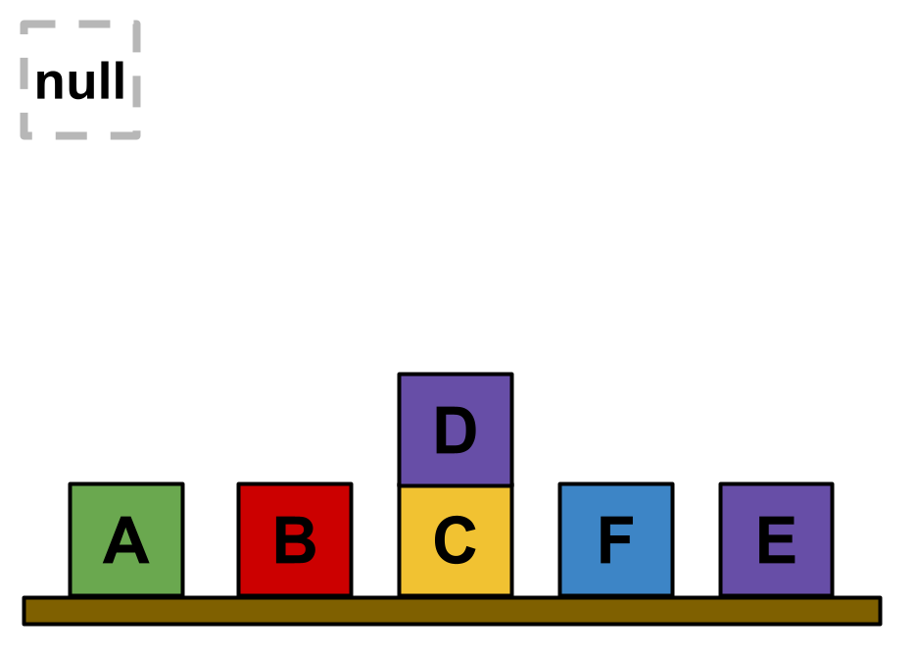
ColorBlocksworld
Kitchenworld
putdown E
IsOnTable | block | isOnTable
1 | 2 | TRUE
2 | 3 | TRUE
3 | 4 | TRUE
4 | 5 | FALSE
5 | 6 | TRUE
6 | 7 | TRUE
IsClear | block | isClear
1 | 2 | TRUE
2 | 3 | TRUE
3 | 4 | FALSE
4 | 5 | TRUE
5 | 6 | TRUE
6 | 7 | TRUE
HasColor | block | hasColor
1 | 2 | green
2 | 3 | red
3 | 4 | yellow
4 | 5 | purple
5 | 6 | purple
6 | 7 | blue
HasLabel | block | hasLabel
1 | 1 | null
2 | 2 | A
3 | 3 | B
4 | 4 | C
5 | 5 | D
6 | 6 | E
7 | 7 | F
Empty | isEmpty
1 | 1
Gripper | isHolding
1 | 1
On | on_l | on_r
1 | 5 | 4

Slide 4
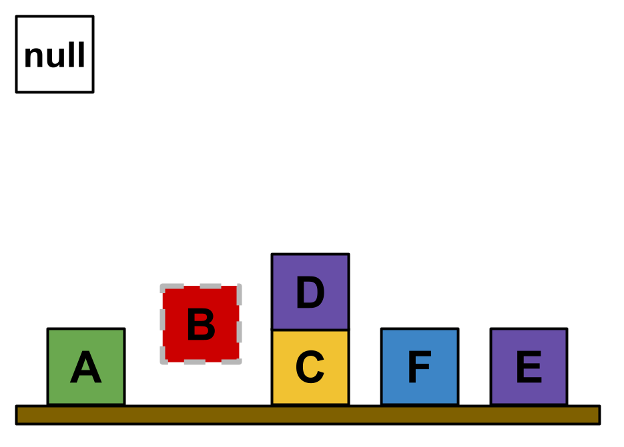
ColorBlocksworld
Kitchenworld
pickup B
IsOnTable | block | isOnTable
1 | 2 | TRUE
2 | 3 | FALSE
3 | 4 | TRUE
4 | 5 | FALSE
5 | 6 | TRUE
6 | 7 | TRUE
IsClear | block | isClear
1 | 2 | TRUE
2 | 3 | TRUE
3 | 4 | FALSE
4 | 5 | TRUE
5 | 6 | TRUE
6 | 7 | TRUE
HasColor | block | hasColor
1 | 2 | green
2 | 3 | red
3 | 4 | yellow
4 | 5 | purple
5 | 6 | purple
6 | 7 | blue
HasLabel | block | hasLabel
1 | 1 | null
2 | 2 | A
3 | 3 | B
4 | 4 | C
5 | 5 | D
6 | 6 | E
7 | 7 | F
Empty | isEmpty
1 | 1
Gripper | isHolding
1 | 3
On | on_l | on_r
1 | 5 | 4

Slide 5
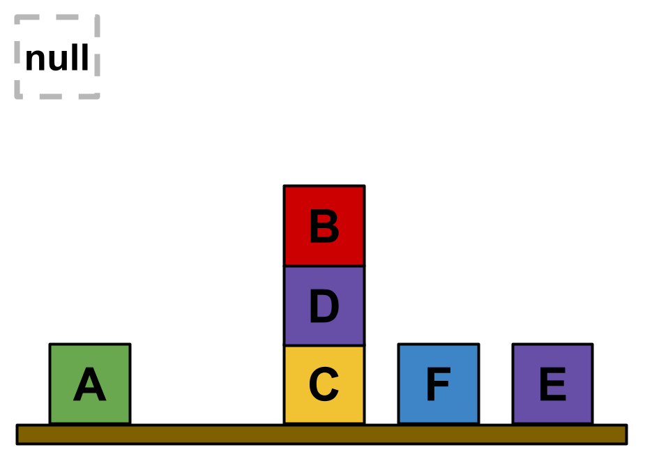
ColorBlocksworld
Kitchenworld
stack B D
IsOnTable | block | isOnTable
1 | 2 | TRUE
2 | 3 | FALSE
3 | 4 | TRUE
4 | 5 | FALSE
5 | 6 | TRUE
6 | 7 | TRUE
IsClear | block | isClear
1 | 2 | TRUE
2 | 3 | TRUE
3 | 4 | FALSE
4 | 5 | FALSE
5 | 6 | TRUE
6 | 7 | TRUE
HasColor | block | hasColor
1 | 2 | green
2 | 3 | red
3 | 4 | yellow
4 | 5 | purple
5 | 6 | purple
6 | 7 | blue
HasLabel | block | hasLabel
1 | 1 | null
2 | 2 | A
3 | 3 | B
4 | 4 | C
5 | 5 | D
6 | 6 | E
7 | 7 | F
Empty | isEmpty
1 | 1
Gripper | isHolding
1 | 1
On | on_l | on_r
1 | 5 | 4
2 | 3 | 5

Slide 6
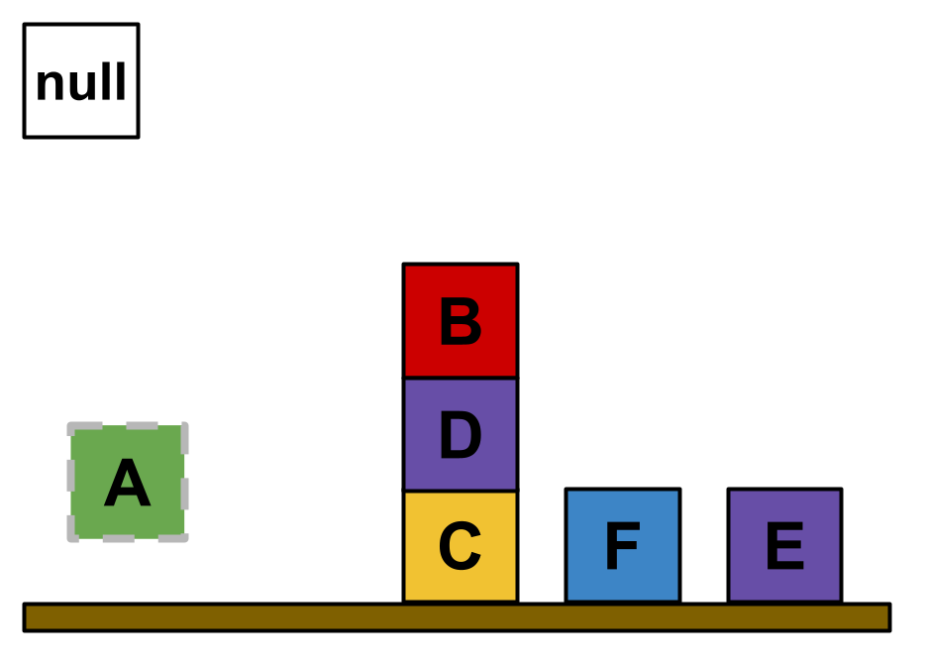
ColorBlocksworld
Kitchenworld
pickup A
IsOnTable | block | isOnTable
1 | 2 | FALSE
2 | 3 | FALSE
3 | 4 | TRUE
4 | 5 | FALSE
5 | 6 | TRUE
6 | 7 | TRUE
IsClear | block | isClear
1 | 2 | TRUE
2 | 3 | TRUE
3 | 4 | FALSE
4 | 5 | FALSE
5 | 6 | TRUE
6 | 7 | TRUE
HasColor | block | hasColor
1 | 2 | green
2 | 3 | red
3 | 4 | yellow
4 | 5 | purple
5 | 6 | purple
6 | 7 | blue
HasLabel | block | hasLabel
1 | 1 | null
2 | 2 | A
3 | 3 | B
4 | 4 | C
5 | 5 | D
6 | 6 | E
7 | 7 | F
Empty | isEmpty
1 | 1
Gripper | isHolding
1 | 2
On | on_l | on_r
1 | 5 | 4
2 | 3 | 5

Slide 7
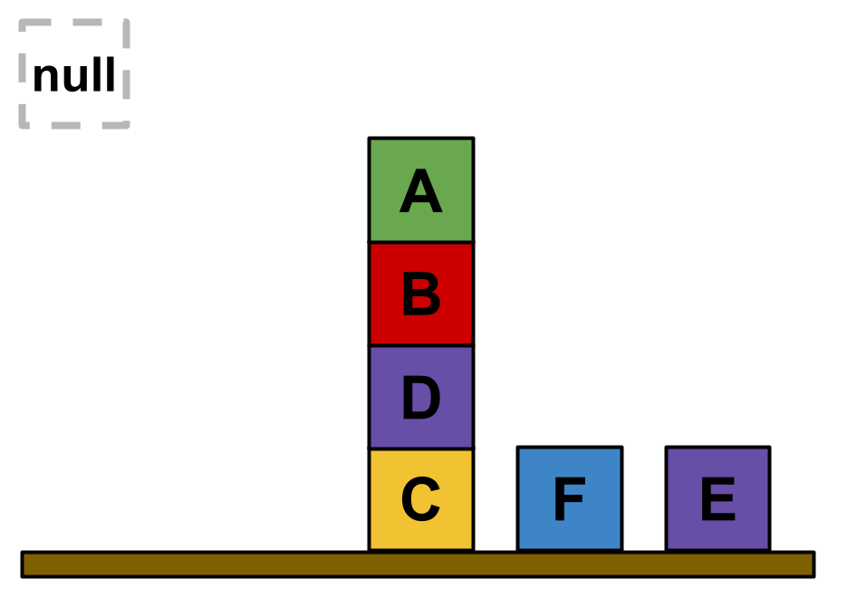
ColorBlocksworld
Kitchenworld
stack A B
IsOnTable | block | isOnTable
1 | 2 | FALSE
2 | 3 | FALSE
3 | 4 | TRUE
4 | 5 | FALSE
5 | 6 | TRUE
6 | 7 | TRUE
IsClear | block | isClear
1 | 2 | TRUE
2 | 3 | FALSE
3 | 4 | FALSE
4 | 5 | FALSE
5 | 6 | TRUE
6 | 7 | TRUE
HasColor | block | hasColor
1 | 2 | green
2 | 3 | red
3 | 4 | yellow
4 | 5 | purple
5 | 6 | purple
6 | 7 | blue
HasLabel | block | hasLabel
1 | 1 | null
2 | 2 | A
3 | 3 | B
4 | 4 | C
5 | 5 | D
6 | 6 | E
7 | 7 | F
Empty | isEmpty
1 | 1
Gripper | isHolding
1 | 1
On | on_l | on_r
1 | 5 | 4
2 | 3 | 5
3 | 2 | 3

Slide 8
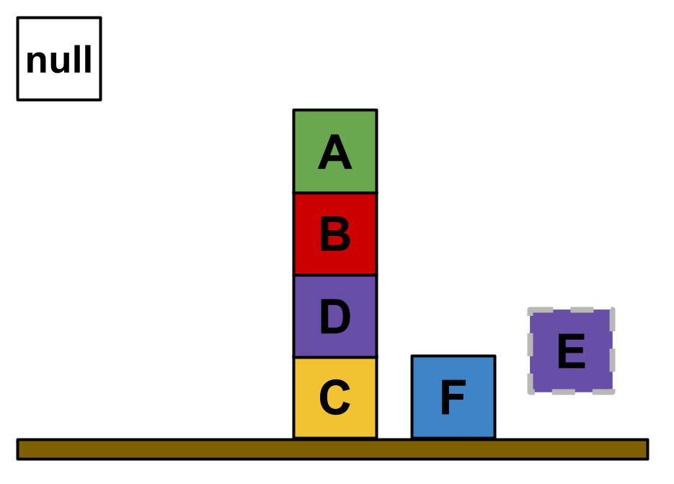
ColorBlocksworld
Kitchenworld
pickup E
IsOnTable | block | isOnTable
1 | 2 | FALSE
2 | 3 | FALSE
3 | 4 | TRUE
4 | 5 | FALSE
5 | 6 | FALSE
6 | 7 | TRUE
IsClear | block | isClear
1 | 2 | TRUE
2 | 3 | FALSE
3 | 4 | FALSE
4 | 5 | FALSE
5 | 6 | TRUE
6 | 7 | TRUE
HasColor | block | hasColor
1 | 2 | green
2 | 3 | red
3 | 4 | yellow
4 | 5 | purple
5 | 6 | purple
6 | 7 | blue
HasLabel | block | hasLabel
1 | 1 | null
2 | 2 | A
3 | 3 | B
4 | 4 | C
5 | 5 | D
6 | 6 | E
7 | 7 | F
Empty | isEmpty
1 | 1
Gripper | isHolding
1 | 6
On | on_l | on_r
1 | 5 | 4
2 | 3 | 5
3 | 2 | 3

Slide 9
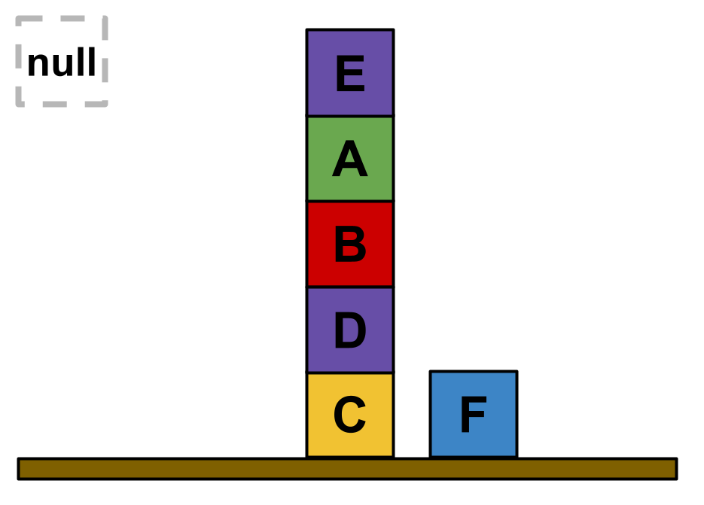
ColorBlocksworld
Kitchenworld
stack E A
IsOnTable | block | isOnTable
1 | 2 | FALSE
2 | 3 | FALSE
3 | 4 | TRUE
4 | 5 | FALSE
5 | 6 | FALSE
6 | 7 | TRUE
IsClear | block | isClear
1 | 2 | FALSE
2 | 3 | FALSE
3 | 4 | FALSE
4 | 5 | FALSE
5 | 6 | TRUE
6 | 7 | TRUE
HasColor | block | hasColor
1 | 2 | green
2 | 3 | red
3 | 4 | yellow
4 | 5 | purple
5 | 6 | purple
6 | 7 | blue
HasLabel | block | hasLabel
1 | 1 | null
2 | 2 | A
3 | 3 | B
4 | 4 | C
5 | 5 | D
6 | 6 | E
7 | 7 | F
Empty | isEmpty
1 | 1
Gripper | isHolding
1 | 1
On | on_l | on_r
1 | 5 | 4
2 | 3 | 5
3 | 2 | 3
4 | 6 | 2

Slide 10
ColorBlocksworld
Kitchenworld
IsOnTable | block | isOnTable
1 | 2 | FALSE
2 | 3 | FALSE
3 | 4 | TRUE
4 | 5 | FALSE
5 | 6 | FALSE
6 | 7 | TRUE
IsClear | block | isClear
1 | 2 | FALSE
2 | 3 | FALSE
3 | 4 | FALSE
4 | 5 | FALSE
5 | 6 | TRUE
6 | 7 | TRUE
HasColor | block | hasColor
1 | 2 | green
2 | 3 | red
3 | 4 | yellow
4 | 5 | purple
5 | 6 | purple
6 | 7 | blue
HasLabel | block | hasLabel
1 | 1 | null
2 | 2 | A
3 | 3 | B
4 | 4 | C
5 | 5 | D
6 | 6 | E
7 | 7 | F
Empty | isEmpty
1 | 1
Gripper | isHolding
1 | 1
On | on_l | on_r
1 | 5 | 4
2 | 3 | 5
3 | 2 | 3
4 | 6 | 2

Slide 11
ColorBlocksworld
Kitchenworld
IsOnTable | block | isOnTable
1 | 2 | FALSE
2 | 3 | FALSE
3 | 4 | TRUE
4 | 5 | FALSE
5 | 6 | FALSE
6 | 7 | TRUE
IsClear | block | isClear
1 | 2 | FALSE
2 | 3 | FALSE
3 | 4 | FALSE
4 | 5 | FALSE
5 | 6 | TRUE
6 | 7 | TRUE
LettuceSliced | IsObject | IsReceptacle | HasTemperature | HasMass | HasMaterials
1 | 2 | 2 | 0 | 0 | Unknown
TomatoSliced | IsObject | IsReceptacle | HasTemperature | HasMass | HasMaterials
1 | 3 | 3 | 0 | 0 | Unknown
Plate | IsObject | IsReceptacle | HasTemperature | HasMass | HasMaterials
1 | 4 | 4 | 0 | 0 | Unknown
HasColor | block | hasColor
1 | 2 | green
2 | 3 | red
3 | 4 | yellow
4 | 5 | purple
5 | 6 | purple
6 | 7 | blue
HasLabel | block | hasLabel
1 | 1 | null
2 | 2 | A
3 | 3 | B
4 | 4 | C
5 | 5 | D
6 | 6 | E
7 | 7 | F
BreadSliced | IsObject | IsReceptacle | HasTemperature | HasMass | HasMaterials
1 | 5 | 5 | 0 | 0 | Unknown
2 | 6 | 6 | 0 | 0 | Unknown
Knife | IsObject | HasTemperature | HasMass | HasMaterials
1 | 7 | 0 | 0 | Unknown
Empty | isEmpty
1 | 1
Gripper | isHolding
1 | 1
Empty | isEmpty
1 | 1
Gripper | isHolding
1 | 1
On | on_l | on_r
1 | 5 | 4
2 | 3 | 5
3 | 2 | 3
4 | 6 | 2
InReceptacle | inReceptacle_l | inReceptacle_r
1 | 6 | 5
2 | 5 | 4

Slide 12
ColorBlocksworld
Kitchenworld
IsOnTable | block | isOnTable
1 | 2 | FALSE
2 | 3 | FALSE
3 | 4 | TRUE
4 | 5 | FALSE
5 | 6 | FALSE
6 | 7 | TRUE
IsClear | block | isClear
1 | 2 | FALSE
2 | 3 | FALSE
3 | 4 | FALSE
4 | 5 | FALSE
5 | 6 | TRUE
6 | 7 | TRUE
LettuceSliced | IsObject | IsReceptacle | HasTemperature | HasMass | HasMaterials
1 | 2 | 2 | 0 | 0 | Unknown
TomatoSliced | IsObject | IsReceptacle | HasTemperature | HasMass | HasMaterials
1 | 3 | 3 | 0 | 0 | Unknown
Plate | IsObject | IsReceptacle | HasTemperature | HasMass | HasMaterials
1 | 4 | 4 | 0 | 0 | Unknown
HasColor | block | hasColor
1 | 2 | green
2 | 3 | red
3 | 4 | yellow
4 | 5 | purple
5 | 6 | purple
6 | 7 | blue
HasLabel | block | hasLabel
1 | 1 | null
2 | 2 | A
3 | 3 | B
4 | 4 | C
5 | 5 | D
6 | 6 | E
7 | 7 | F
BreadSliced | IsObject | IsReceptacle | HasTemperature | HasMass | HasMaterials
1 | 5 | 5 | 0 | 0 | Unknown
2 | 6 | 6 | 0 | 0 | Unknown
Knife | IsObject | HasTemperature | HasMass | HasMaterials
1 | 7 | 0 | 0 | Unknown
Empty | isEmpty
1 | 1
Gripper | isHolding
1 | 1
Empty | isEmpty
1 | 1
Gripper | isHolding
1 | 1
On | on_l | on_r
1 | 5 | 4
2 | 3 | 5
3 | 2 | 3
4 | 6 | 2
InReceptacle | inReceptacle_l | inReceptacle_r
1 | 6 | 5
2 | 5 | 4

Slide 13
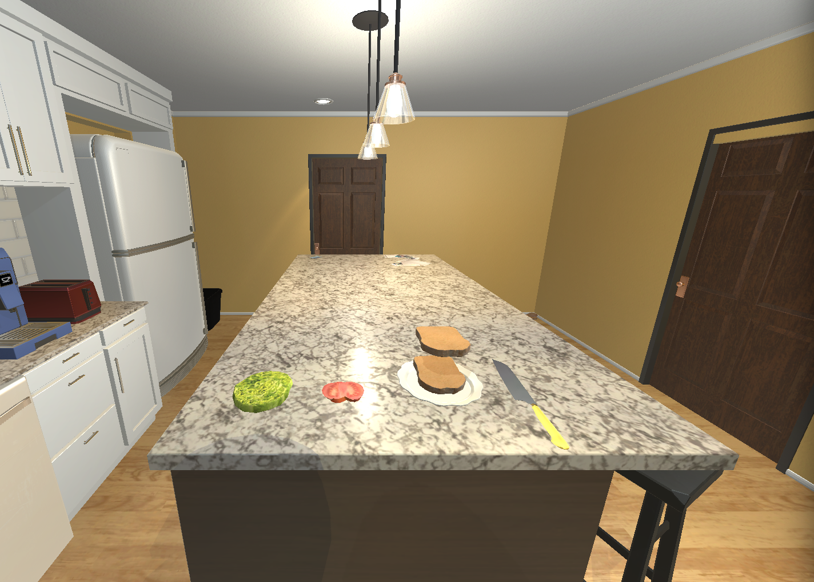
ColorBlocksworld
Kitchenworld
unstack E D
IsOnTable | block | isOnTable
1 | 2 | FALSE
2 | 3 | FALSE
3 | 4 | TRUE
4 | 5 | FALSE
5 | 6 | FALSE
6 | 7 | TRUE
IsClear | block | isClear
1 | 2 | FALSE
2 | 3 | FALSE
3 | 4 | FALSE
4 | 5 | FALSE
5 | 6 | TRUE
6 | 7 | TRUE
LettuceSliced | IsObject | IsReceptacle | HasTemperature | HasMass | HasMaterials
1 | 2 | 2 | 0 | 0 | Unknown
TomatoSliced | IsObject | IsReceptacle | HasTemperature | HasMass | HasMaterials
1 | 3 | 3 | 0 | 0 | Unknown
Plate | IsObject | IsReceptacle | HasTemperature | HasMass | HasMaterials
1 | 4 | 4 | 0 | 0 | Unknown
HasColor | block | hasColor
1 | 2 | green
2 | 3 | red
3 | 4 | yellow
4 | 5 | purple
5 | 6 | purple
6 | 7 | blue
HasLabel | block | hasLabel
1 | 1 | null
2 | 2 | A
3 | 3 | B
4 | 4 | C
5 | 5 | D
6 | 6 | E
7 | 7 | F
BreadSliced | IsObject | IsReceptacle | HasTemperature | HasMass | HasMaterials
1 | 5 | 5 | 0 | 0 | Unknown
2 | 6 | 6 | 0 | 0 | Unknown
Knife | IsObject | HasTemperature | HasMass | HasMaterials
1 | 7 | 0 | 0 | Unknown
Empty | isEmpty
1 | 1
Gripper | isHolding
1 | 6
Empty | isEmpty
1 | 1
Gripper | isHolding
1 | 1
On | on_l | on_r
1 | 5 | 4
2 | 3 | 5
3 | 2 | 3
4 | 6 | 2
InReceptacle | inReceptacle_l | inReceptacle_r
1 | 5 | 4

Slide 14

ColorBlocksworld
Kitchenworld
putdown E
IsOnTable | block | isOnTable
1 | 2 | FALSE
2 | 3 | FALSE
3 | 4 | TRUE
4 | 5 | FALSE
5 | 6 | FALSE
6 | 7 | TRUE
IsClear | block | isClear
1 | 2 | FALSE
2 | 3 | FALSE
3 | 4 | FALSE
4 | 5 | FALSE
5 | 6 | TRUE
6 | 7 | TRUE
LettuceSliced | IsObject | IsReceptacle | HasTemperature | HasMass | HasMaterials
1 | 2 | 2 | 0 | 0 | Unknown
TomatoSliced | IsObject | IsReceptacle | HasTemperature | HasMass | HasMaterials
1 | 3 | 3 | 0 | 0 | Unknown
Plate | IsObject | IsReceptacle | HasTemperature | HasMass | HasMaterials
1 | 4 | 4 | 0 | 0 | Unknown
HasColor | block | hasColor
1 | 2 | green
2 | 3 | red
3 | 4 | yellow
4 | 5 | purple
5 | 6 | purple
6 | 7 | blue
HasLabel | block | hasLabel
1 | 1 | null
2 | 2 | A
3 | 3 | B
4 | 4 | C
5 | 5 | D
6 | 6 | E
7 | 7 | F
BreadSliced | IsObject | IsReceptacle | HasTemperature | HasMass | HasMaterials
1 | 5 | 5 | 0 | 0 | Unknown
2 | 6 | 6 | 0 | 0 | Unknown
Knife | IsObject | HasTemperature | HasMass | HasMaterials
1 | 7 | 0 | 0 | Unknown
Empty | isEmpty
1 | 1
Gripper | isHolding
1 | 1
Empty | isEmpty
1 | 1
Gripper | isHolding
1 | 1
On | on_l | on_r
1 | 5 | 4
2 | 3 | 5
3 | 2 | 3
4 | 6 | 2
InReceptacle | inReceptacle_l | inReceptacle_r
1 | 5 | 4

Slide 15
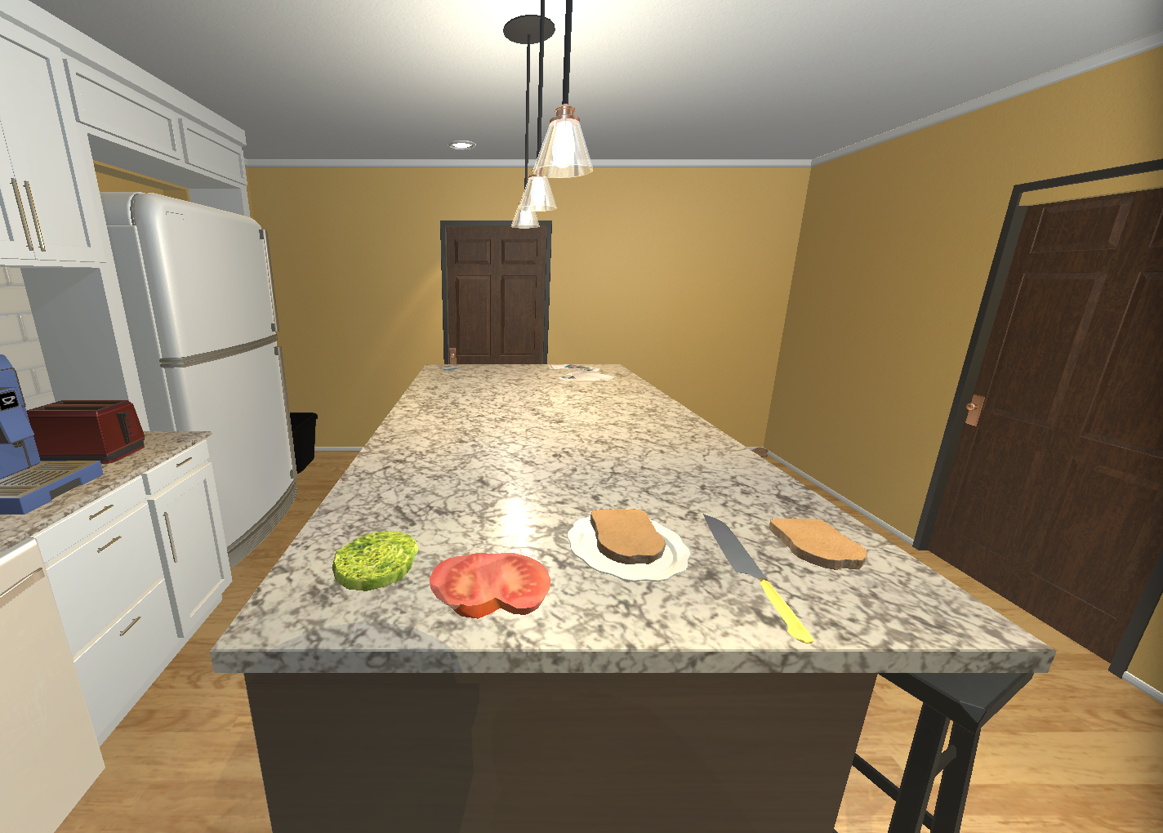
ColorBlocksworld
Kitchenworld
pickup B
IsOnTable | block | isOnTable
1 | 2 | FALSE
2 | 3 | FALSE
3 | 4 | TRUE
4 | 5 | FALSE
5 | 6 | FALSE
6 | 7 | TRUE
IsClear | block | isClear
1 | 2 | FALSE
2 | 3 | FALSE
3 | 4 | FALSE
4 | 5 | FALSE
5 | 6 | TRUE
6 | 7 | TRUE
LettuceSliced | IsObject | IsReceptacle | HasTemperature | HasMass | HasMaterials
1 | 2 | 2 | 0 | 0 | Unknown
TomatoSliced | IsObject | IsReceptacle | HasTemperature | HasMass | HasMaterials
1 | 3 | 3 | 0 | 0 | Unknown
Plate | IsObject | IsReceptacle | HasTemperature | HasMass | HasMaterials
1 | 4 | 4 | 0 | 0 | Unknown
HasColor | block | hasColor
1 | 2 | green
2 | 3 | red
3 | 4 | yellow
4 | 5 | purple
5 | 6 | purple
6 | 7 | blue
HasLabel | block | hasLabel
1 | 1 | null
2 | 2 | A
3 | 3 | B
4 | 4 | C
5 | 5 | D
6 | 6 | E
7 | 7 | F
BreadSliced | IsObject | IsReceptacle | HasTemperature | HasMass | HasMaterials
1 | 5 | 5 | 0 | 0 | Unknown
2 | 6 | 6 | 0 | 0 | Unknown
Knife | IsObject | HasTemperature | HasMass | HasMaterials
1 | 7 | 0 | 0 | Unknown
Empty | isEmpty
1 | 1
Gripper | isHolding
1 | 3
Empty | isEmpty
1 | 1
Gripper | isHolding
1 | 1
On | on_l | on_r
1 | 5 | 4
2 | 3 | 5
3 | 2 | 3
4 | 6 | 2
InReceptacle | inReceptacle_l | inReceptacle_r
1 | 5 | 4

Slide 16

ColorBlocksworld
Kitchenworld
stack B D
IsOnTable | block | isOnTable
1 | 2 | FALSE
2 | 3 | FALSE
3 | 4 | TRUE
4 | 5 | FALSE
5 | 6 | FALSE
6 | 7 | TRUE
IsClear | block | isClear
1 | 2 | FALSE
2 | 3 | FALSE
3 | 4 | FALSE
4 | 5 | FALSE
5 | 6 | TRUE
6 | 7 | TRUE
LettuceSliced | IsObject | IsReceptacle | HasTemperature | HasMass | HasMaterials
1 | 2 | 2 | 0 | 0 | Unknown
TomatoSliced | IsObject | IsReceptacle | HasTemperature | HasMass | HasMaterials
1 | 3 | 3 | 0 | 0 | Unknown
Plate | IsObject | IsReceptacle | HasTemperature | HasMass | HasMaterials
1 | 4 | 4 | 0 | 0 | Unknown
HasColor | block | hasColor
1 | 2 | green
2 | 3 | red
3 | 4 | yellow
4 | 5 | purple
5 | 6 | purple
6 | 7 | blue
HasLabel | block | hasLabel
1 | 1 | null
2 | 2 | A
3 | 3 | B
4 | 4 | C
5 | 5 | D
6 | 6 | E
7 | 7 | F
BreadSliced | IsObject | IsReceptacle | HasTemperature | HasMass | HasMaterials
1 | 5 | 5 | 0 | 0 | Unknown
2 | 6 | 6 | 0 | 0 | Unknown
Knife | IsObject | HasTemperature | HasMass | HasMaterials
1 | 7 | 0 | 0 | Unknown
Empty | isEmpty
1 | 1
Gripper | isHolding
1 | 1
Empty | isEmpty
1 | 1
Gripper | isHolding
1 | 1
On | on_l | on_r
1 | 5 | 4
2 | 3 | 5
3 | 2 | 3
4 | 6 | 2
InReceptacle | inReceptacle_l | inReceptacle_r
1 | 5 | 4
2 | 3 | 5

Slide 17
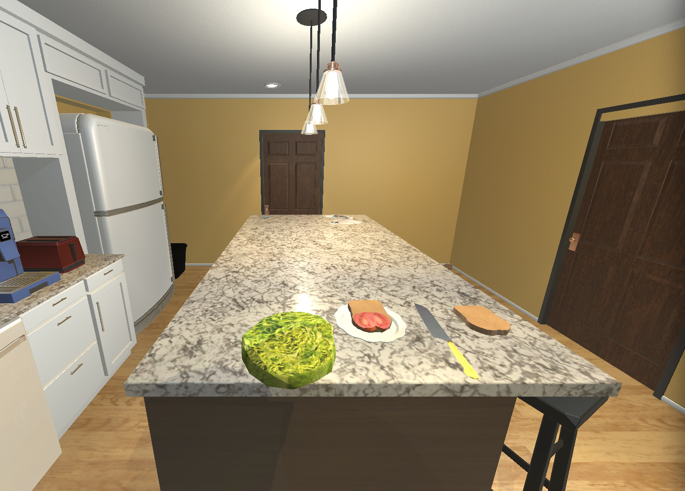
ColorBlocksworld
Kitchenworld
pickup A
IsOnTable | block | isOnTable
1 | 2 | FALSE
2 | 3 | FALSE
3 | 4 | TRUE
4 | 5 | FALSE
5 | 6 | FALSE
6 | 7 | TRUE
IsClear | block | isClear
1 | 2 | FALSE
2 | 3 | FALSE
3 | 4 | FALSE
4 | 5 | FALSE
5 | 6 | TRUE
6 | 7 | TRUE
LettuceSliced | IsObject | IsReceptacle | HasTemperature | HasMass | HasMaterials
1 | 2 | 2 | 0 | 0 | Unknown
TomatoSliced | IsObject | IsReceptacle | HasTemperature | HasMass | HasMaterials
1 | 3 | 3 | 0 | 0 | Unknown
Plate | IsObject | IsReceptacle | HasTemperature | HasMass | HasMaterials
1 | 4 | 4 | 0 | 0 | Unknown
HasColor | block | hasColor
1 | 2 | green
2 | 3 | red
3 | 4 | yellow
4 | 5 | purple
5 | 6 | purple
6 | 7 | blue
HasLabel | block | hasLabel
1 | 1 | null
2 | 2 | A
3 | 3 | B
4 | 4 | C
5 | 5 | D
6 | 6 | E
7 | 7 | F
BreadSliced | IsObject | IsReceptacle | HasTemperature | HasMass | HasMaterials
1 | 5 | 5 | 0 | 0 | Unknown
2 | 6 | 6 | 0 | 0 | Unknown
Knife | IsObject | HasTemperature | HasMass | HasMaterials
1 | 7 | 0 | 0 | Unknown
Empty | isEmpty
1 | 1
Gripper | isHolding
1 | 2
Empty | isEmpty
1 | 1
Gripper | isHolding
1 | 1
On | on_l | on_r
1 | 5 | 4
2 | 3 | 5
3 | 2 | 3
4 | 6 | 2
InReceptacle | inReceptacle_l | inReceptacle_r
1 | 5 | 4
2 | 3 | 5

Slide 18
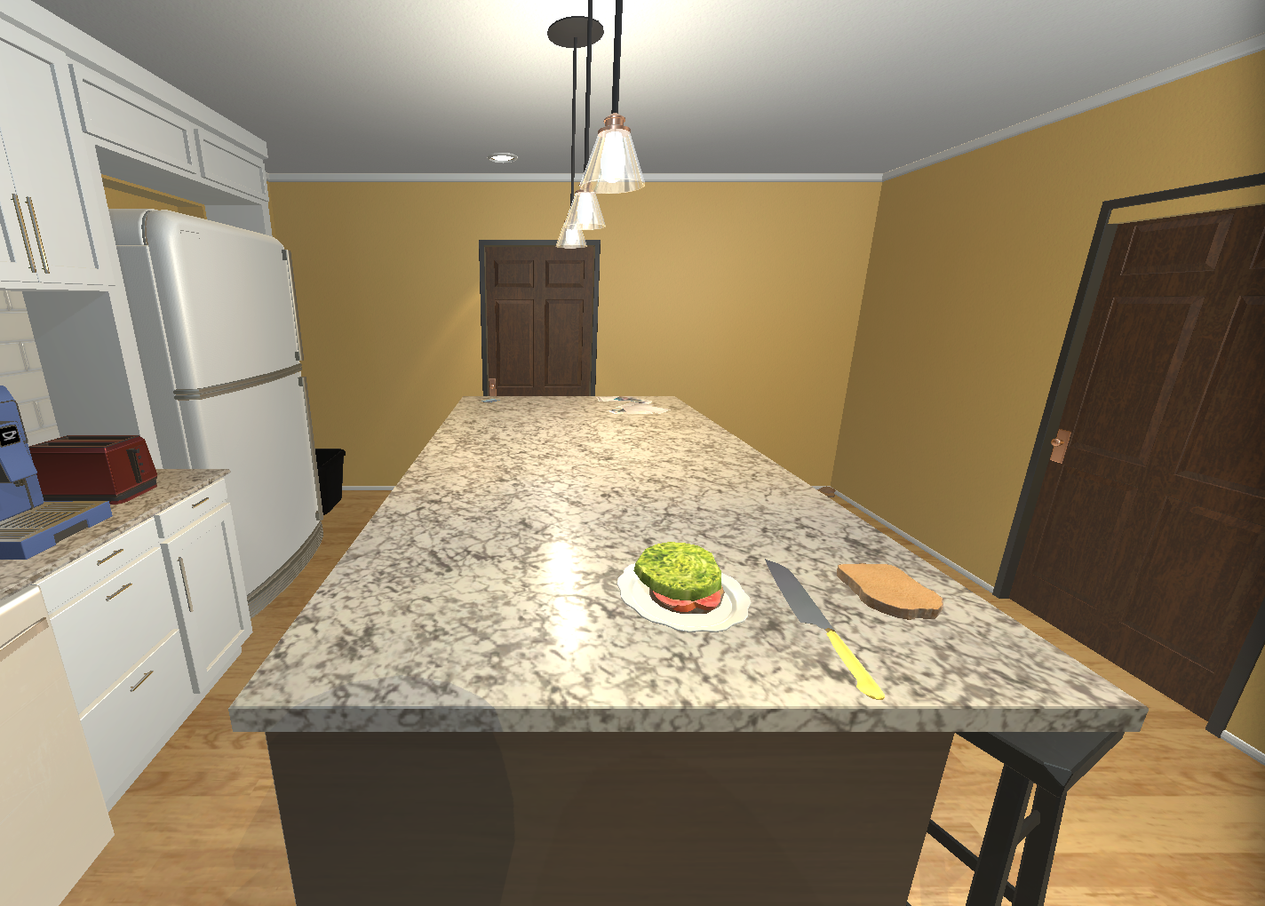
ColorBlocksworld
Kitchenworld
stack A B
IsOnTable | block | isOnTable
1 | 2 | FALSE
2 | 3 | FALSE
3 | 4 | TRUE
4 | 5 | FALSE
5 | 6 | FALSE
6 | 7 | TRUE
IsClear | block | isClear
1 | 2 | FALSE
2 | 3 | FALSE
3 | 4 | FALSE
4 | 5 | FALSE
5 | 6 | TRUE
6 | 7 | TRUE
LettuceSliced | IsObject | IsReceptacle | HasTemperature | HasMass | HasMaterials
1 | 2 | 2 | 0 | 0 | Unknown
TomatoSliced | IsObject | IsReceptacle | HasTemperature | HasMass | HasMaterials
1 | 3 | 3 | 0 | 0 | Unknown
Plate | IsObject | IsReceptacle | HasTemperature | HasMass | HasMaterials
1 | 4 | 4 | 0 | 0 | Unknown
HasColor | block | hasColor
1 | 2 | green
2 | 3 | red
3 | 4 | yellow
4 | 5 | purple
5 | 6 | purple
6 | 7 | blue
HasLabel | block | hasLabel
1 | 1 | null
2 | 2 | A
3 | 3 | B
4 | 4 | C
5 | 5 | D
6 | 6 | E
7 | 7 | F
BreadSliced | IsObject | IsReceptacle | HasTemperature | HasMass | HasMaterials
1 | 5 | 5 | 0 | 0 | Unknown
2 | 6 | 6 | 0 | 0 | Unknown
Knife | IsObject | HasTemperature | HasMass | HasMaterials
1 | 7 | 0 | 0 | Unknown
Empty | isEmpty
1 | 1
Gripper | isHolding
1 | 1
Empty | isEmpty
1 | 1
Gripper | isHolding
1 | 1
On | on_l | on_r
1 | 5 | 4
2 | 3 | 5
3 | 2 | 3
4 | 6 | 2
InReceptacle | inReceptacle_l | inReceptacle_r
1 | 5 | 4
2 | 3 | 5
3 | 2 | 3

Slide 19
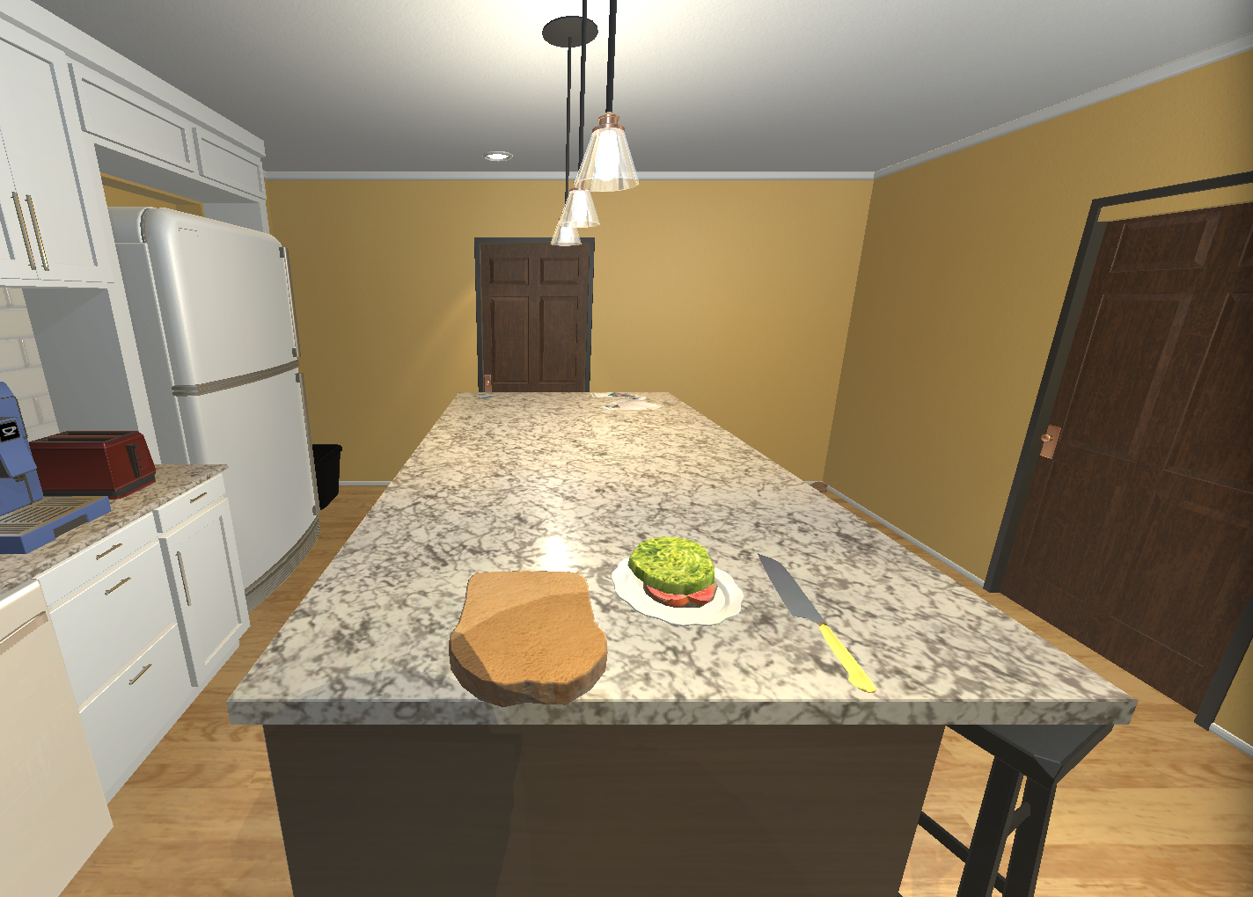
ColorBlocksworld
Kitchenworld
pickup E
IsOnTable | block | isOnTable
1 | 2 | FALSE
2 | 3 | FALSE
3 | 4 | TRUE
4 | 5 | FALSE
5 | 6 | FALSE
6 | 7 | TRUE
IsClear | block | isClear
1 | 2 | FALSE
2 | 3 | FALSE
3 | 4 | FALSE
4 | 5 | FALSE
5 | 6 | TRUE
6 | 7 | TRUE
LettuceSliced | IsObject | IsReceptacle | HasTemperature | HasMass | HasMaterials
1 | 2 | 2 | 0 | 0 | Unknown
TomatoSliced | IsObject | IsReceptacle | HasTemperature | HasMass | HasMaterials
1 | 3 | 3 | 0 | 0 | Unknown
Plate | IsObject | IsReceptacle | HasTemperature | HasMass | HasMaterials
1 | 4 | 4 | 0 | 0 | Unknown
HasColor | block | hasColor
1 | 2 | green
2 | 3 | red
3 | 4 | yellow
4 | 5 | purple
5 | 6 | purple
6 | 7 | blue
HasLabel | block | hasLabel
1 | 1 | null
2 | 2 | A
3 | 3 | B
4 | 4 | C
5 | 5 | D
6 | 6 | E
7 | 7 | F
BreadSliced | IsObject | IsReceptacle | HasTemperature | HasMass | HasMaterials
1 | 5 | 5 | 0 | 0 | Unknown
2 | 6 | 6 | 0 | 0 | Unknown
Knife | IsObject | HasTemperature | HasMass | HasMaterials
1 | 7 | 0 | 0 | Unknown
Empty | isEmpty
1 | 1
Gripper | isHolding
1 | 6
Empty | isEmpty
1 | 1
Gripper | isHolding
1 | 1
On | on_l | on_r
1 | 5 | 4
2 | 3 | 5
3 | 2 | 3
4 | 6 | 2
InReceptacle | inReceptacle_l | inReceptacle_r
1 | 5 | 4
2 | 3 | 5
3 | 2 | 3

Slide 20

ColorBlocksworld
Kitchenworld
stack E A
IsOnTable | block | isOnTable
1 | 2 | FALSE
2 | 3 | FALSE
3 | 4 | TRUE
4 | 5 | FALSE
5 | 6 | FALSE
6 | 7 | TRUE
IsClear | block | isClear
1 | 2 | FALSE
2 | 3 | FALSE
3 | 4 | FALSE
4 | 5 | FALSE
5 | 6 | TRUE
6 | 7 | TRUE
LettuceSliced | IsObject | IsReceptacle | HasTemperature | HasMass | HasMaterials
1 | 2 | 2 | 0 | 0 | Unknown
TomatoSliced | IsObject | IsReceptacle | HasTemperature | HasMass | HasMaterials
1 | 3 | 3 | 0 | 0 | Unknown
Plate | IsObject | IsReceptacle | HasTemperature | HasMass | HasMaterials
1 | 4 | 4 | 0 | 0 | Unknown
HasColor | block | hasColor
1 | 2 | green
2 | 3 | red
3 | 4 | yellow
4 | 5 | purple
5 | 6 | purple
6 | 7 | blue
HasLabel | block | hasLabel
1 | 1 | null
2 | 2 | A
3 | 3 | B
4 | 4 | C
5 | 5 | D
6 | 6 | E
7 | 7 | F
BreadSliced | IsObject | IsReceptacle | HasTemperature | HasMass | HasMaterials
1 | 5 | 5 | 0 | 0 | Unknown
2 | 6 | 6 | 0 | 0 | Unknown
Knife | IsObject | HasTemperature | HasMass | HasMaterials
1 | 7 | 0 | 0 | Unknown
Empty | isEmpty
1 | 1
Gripper | isHolding
1 | 6
Empty | isEmpty
1 | 1
Gripper | isHolding
1 | 1
On | on_l | on_r
1 | 5 | 4
2 | 3 | 5
3 | 2 | 3
4 | 6 | 2
InReceptacle | inReceptacle_l | inReceptacle_r
1 | 5 | 4
2 | 3 | 5
3 | 2 | 3
4 | 6 | 2

Slide 21
ColorBlocksworld
Kitchenworld
IsOnTable | block | isOnTable
1 | 2 | FALSE
2 | 3 | FALSE
3 | 4 | TRUE
4 | 5 | FALSE
5 | 6 | FALSE
6 | 7 | TRUE
IsClear | block | isClear
1 | 2 | FALSE
2 | 3 | FALSE
3 | 4 | FALSE
4 | 5 | FALSE
5 | 6 | TRUE
6 | 7 | TRUE
LettuceSliced | IsObject | IsReceptacle | HasTemperature | HasMass | HasMaterials
1 | 2 | 2 | 0 | 0 | Unknown
TomatoSliced | IsObject | IsReceptacle | HasTemperature | HasMass | HasMaterials
1 | 3 | 3 | 0 | 0 | Unknown
Plate | IsObject | IsReceptacle | HasTemperature | HasMass | HasMaterials
1 | 4 | 4 | 0 | 0 | Unknown
HasColor | block | hasColor
1 | 2 | green
2 | 3 | red
3 | 4 | yellow
4 | 5 | purple
5 | 6 | purple
6 | 7 | blue
HasLabel | block | hasLabel
1 | 1 | null
2 | 2 | A
3 | 3 | B
4 | 4 | C
5 | 5 | D
6 | 6 | E
7 | 7 | F
BreadSliced | IsObject | IsReceptacle | HasTemperature | HasMass | HasMaterials
1 | 5 | 5 | 0 | 0 | Unknown
2 | 6 | 6 | 0 | 0 | Unknown
Knife | IsObject | HasTemperature | HasMass | HasMaterials
1 | 7 | 0 | 0 | Unknown
Empty | isEmpty
1 | 1
Gripper | isHolding
1 | 6
Empty | isEmpty
1 | 1
Gripper | isHolding
1 | 1
On | on_l | on_r
1 | 5 | 4
2 | 3 | 5
3 | 2 | 3
4 | 6 | 2
InReceptacle | inReceptacle_l | inReceptacle_r
1 | 5 | 4
2 | 3 | 5
3 | 2 | 3
4 | 6 | 2

